Slide 1
CIS 530: Text Processing Wrap up & Logistic Regression
Mondays and Wednesdays 1:30-3pm 3401 Walnut, room 401B Annenberg 110 computational-linguistics-class.org
Professor Callison-Burch

Slide 2
Reminders
Quiz 1 is due tonight before 11:59pm.
Help us help you on Piazza
Read Textbook Chapter 5

Slide 3
Wrap-up: Text Processing
Read: Jurafsky and Martin Chapter 2
Word Normalization and Stemming

Slide 4
Recap: Normalization
Need to “normalize” terms
Information Retrieval: indexed text & query terms must have same form.
We want to match U.S.A. and USA
We implicitly define equivalence classes of terms
e.g., deleting periods in a term
Alternative: asymmetric expansion:
Enter: window Search: window, windows
Enter: windows Search: Windows, windows, window
Enter: Windows Search: Windows
Potentially more powerful, but less efficient

Slide 5
Issues in Tokenization
Finland’s capital → Finland Finlands Finland’s ?
what’re, I’m, isn’t → What are, I am, is not
Hewlett-Packard → Hewlett Packard ?
state-of-the-art → state of the art ?
Lowercase → lower-case lowercase lower case ?
San Francisco → one token or two?
m.p.h., PhD. → ??

Slide 6
Tokenization: language issues
French
L'ensemble → one token or two?
L ? L’ ? Le ?
Want l’ensemble to match with un ensemble
German noun compounds are not segmented
Lebensversicherungsgesellschaftsangestellter
‘life insurance company employee’
German information retrieval needs compound splitter

Slide 7
Tokenization: language issues
Chinese and Japanese no spaces between words:
莎拉波娃现在居住在美国东南部的佛罗里达。
莎拉波娃 现在 居住 在 美国 东南部 的 佛罗里达
Sharapova now lives in US southeastern Florida
Further complicated in Japanese, with multiple alphabets intermingled
Dates/amounts in multiple formats
フォーチュン500社は情報不足のため時間あた$500K(約6,000万円)
Katakana
Hiragana
Kanji
Romaji
End-user can express query entirely in hiragana!
Notes:
In Chinese, for example, words are composed of characters (called hanzi in Chinese). Each character generally represents a single unit of meaning (called a morpheme)
Katakana is a Japanese syllabary, one component of the Japanese writing system along with hiragana,^{[2]} kanji and in some cases the Latin script (known as rōmaji). The
The word hiragana literally means "ordinary" or "simple" kana ("simple" originally as contrasted with kanji).
Kanji are the adopted logographic Chinese characters that are used in the Japanese writing system

Slide 8
Word Tokenization in Chinese
Also called Word Segmentation
Chinese words are composed of characters
Characters are generally 1 syllable and 1 morpheme.
Average word is 2.4 characters long.
Standard baseline segmentation algorithm:
Maximum Matching (also called Greedy)

Slide 9
Maximum Matching Word Segmentation Algorithm
Given a wordlist of Chinese, and a string:
Start a pointer at the beginning of the string
Find the longest word in dictionary that matches the string starting at pointer
Move the pointer over the word in string
Go to 2

Slide 10
Max-match segmentation illustration
Thecatinthehat
Thetabledownthere
Doesn’t generally work in English!
But works surprisingly well in Chinese
莎拉波娃现在居住在美国东南部的佛罗里达。
莎拉波娃 现在 居住 在 美国 东南部 的 佛罗里达
Modern probabilistic segmentation algorithms even better
the cat in the hat
the table down there
theta bled own there

Slide 11
Byte-Pair Encoding for Tokenization
Modern tokenizers use data to automatically determine what size tokens we should use, rather than relying on whitespace, or max-matc
Sometimes we want a space delimited words like spinach to be a token
Other times we might want multi-word units like New York Times
Sometimes we want subword units like morphemes –est or –er
Subword units are helpful for dealing with unknown words.
Notes:
One reason it’s helpful to have subword tokens is to deal with unknown words.
Unknown words are particularly relevant for machine learning systems. As we will see in the next chapter, machine learning systems often learn some facts about words in one corpus (a training corpus) and then use these facts to make decisions about a separate test corpus and its words. Thus if our training corpus contains, say the words low, and lowest, but not lower, but then the word lower appears in our test corpus, our system will not know what to do with it.

Slide 12
Byte-Pair Encoding for Tokenization
The BPE algorithm tokenizes text, such that most tokens are words, but some tokens are frequent morphemes or other subwords like –er. Unseen word can be represented by combining the parts.
BPE was originally used for text compression, but was repurposed for tokenization in 2016 by Rico Sennrich, Barry Haddow, and Alexanra Birch to translate rare and unseen words. Start with a set of symbols that is the set of characters, plus an end of word symbol.

Slide 13
Byte-Pair Encoding for Tokenization
Start with a set of symbols that is the set of characters, plus an end of word symbol.
At each step, count the number of symbol pairs, find the most frequent pair (‘A’, ‘B’), and replace it with the new merged symbol (‘AB’).
Repeat this merge step k times.
The resulting symbol set will consist of the original characters plus k new symbols.

Slide 15
Notes:
Consider the following tiny input dictionary with counts for each word,
which would have the starting vocabulary of 11 letters:

Slide 16
Notes:
We first count all pairs of symbols: the most frequent is the pair r because it occurs in newer (frequency of 6) and wider (frequency of 3) for a total of 9 oc- currences. We then merge these symbols, treating r as one symbol,

Slide 17
Notes:
THEN WE COUNT AGAIN. Now the most frequent pair is e r , which we merge; our system has learned that there should be a token for word-final er, represented as er :

Slide 18
Notes:
THEN WE COUNT AGAIN. Now the most frequent pair is e r , which we merge; our system has learned that there should be a token for word-final er, represented as er :

Slide 19
Notes:
Next e w (total count of 8) get merged to ew:

Slide 20
Notes:
Of course in real algorithms BPE is run with many thousands of merges on a very large input dictionary. The result is that most words will be represented as full symbols, and only the very rare words (and unknown words) will have to be represented by their parts. The full BPE learning algorithm is given in Fig. 2.12.

Slide 21
Basic Text Processing
Word Normalization and Stemming

Slide 22
Normalization
Need to “normalize” terms
Information Retrieval: indexed text & query terms must have same form.
We want to match U.S.A. and USA
We implicitly define equivalence classes of terms
e.g., deleting periods in a term
Alternative: asymmetric expansion:
Enter: window Search: window, windows
Enter: windows Search: Windows, windows, window
Enter: Windows Search: Windows
Potentially more powerful, but less efficient

Slide 23
Case folding
Applications like IR: reduce all letters to lower case
Since users tend to use lower case
Possible exception: upper case in mid-sentence?
e.g., General Motors
Fed vs. fed
SAIL vs. sail
For sentiment analysis, MT, Information extraction
Case is helpful (US versus us is important)

Slide 24
Lemmatization
Reduce inflections or variant forms to base form
am, are, is → be
car, cars, car's, cars' → car
the boy's cars are different colors → the boy car be different color
Lemmatization: have to find correct dictionary headword form
Machine translation
Spanish quiero (‘I want’), quieres (‘you want’) same lemma as querer ‘want’
Notes:
Another part of text normalization is lemmatization, the task of determining that two words have the same root, despite their surface differences. For example, the words sang, sung, and sings are forms of the verb sing. The word sing is the common lemma of these words, and a lemmatizer maps from all of these to sing. Lemmatization is essential for processing morphologically complex languages like Arabic. Stemming refers to a simpler version of lemmatization in which we mainly just strip suffixes from the end of the word.
How about inflected forms like cats versus cat? These two words have the same lemma cat but are different wordforms. A lemma is a set of lexical forms having the same stem, the same major part-of-speech, and the same word sense. The word- form is the full inflected or derived form of the word. For morphologically complex languages like Arabic, we often need to deal with lemmatization. For many tasks in English, however, wordforms are sufficient.

Slide 25
Morphology
Morphemes:
The small meaningful units that make up words
Stems: The core meaning-bearing units
Affixes: Bits and pieces that adhere to stems
Often with grammatical functions

Slide 26
Stemming
Reduce terms to their stems in information retrieval
Stemming is crude chopping of affixes
language dependent
e.g., automate(s), automatic, automation all reduced to automat.
for example compressed
and compression are both
accepted as equivalent to
compress.
for exampl compress and
compress ar both accept
as equival to compress
Notes:
Stemming refers to a simpler version of lemmatization in which we mainly just strip suffixes from the end of the word.

Slide 27
Porter’s algorithm The most common English stemmer
Step 1a
sses → ss caresses → caress
ies → i ponies → poni
ss → ss caress → caress
s → ø cats → cat
Step 1b
(*v*)ing → ø walking → walk
sing → sing
(*v*)ed → ø plastered → plaster
…
Step 2 (for long stems)
ational→ ate relational→ relate
izer→ ize digitizer → digitize
ator→ ate operator → operate
…
Step 3 (for longer stems)
al → ø revival → reviv
able → ø adjustable → adjust
ate → ø activate → activ
…

Slide 28
Viewing morphology in a corpus Why only strip –ing if there is a vowel?
(*v*)ing → ø walking → walk
sing → sing

Slide 29
Viewing morphology in a corpus Why only strip –ing if there is a vowel?
(*v*)ing → ø walking → walk
sing → sing
tr -sc 'A-Za-z' '\n' < shakes.txt | grep ’ing$' | sort | uniq -c | sort –nr
tr -sc 'A-Za-z' '\n' < shakes.txt | grep '[aeiou].*ing$' | sort | uniq -c | sort –nr
1312 King
548 being
541 nothing
388 king
375 bring
358 thing
307 ring
152 something
145 coming
130 morning
548 being
541 nothing
152 something
145 coming
130 morning
122 having
120 living
117 loving
116 Being
102 going
29

Slide 30
Dealing with complex morphology is sometimes necessary
Some languages requires complex morpheme segmentation
Turkish
Uygarlastiramadiklarimizdanmissinizcasina
`(behaving) as if you are among those whom we could not civilize’
Uygar `civilized’ + las `become’
+ tir `cause’ + ama `not able’
+ dik `past’ + lar ‘plural’
+ imiz ‘p1pl’ + dan ‘abl’
+ mis ‘past’ + siniz ‘2pl’ + casina ‘as if’

Slide 31
Basic Text Processing
Sentence Segmentation and Decision Trees

Slide 32
Sentence Segmentation
!, ? are relatively unambiguous
Period “.” is quite ambiguous
Sentence boundary
Abbreviations like Inc. or Dr.
Numbers like .02% or 4.3
Build a binary classifier
Looks at a “.”
Decides EndOfSentence/NotEndOfSentence
Classifiers: hand-written rules, regular expressions, or machine-learning

Slide 33
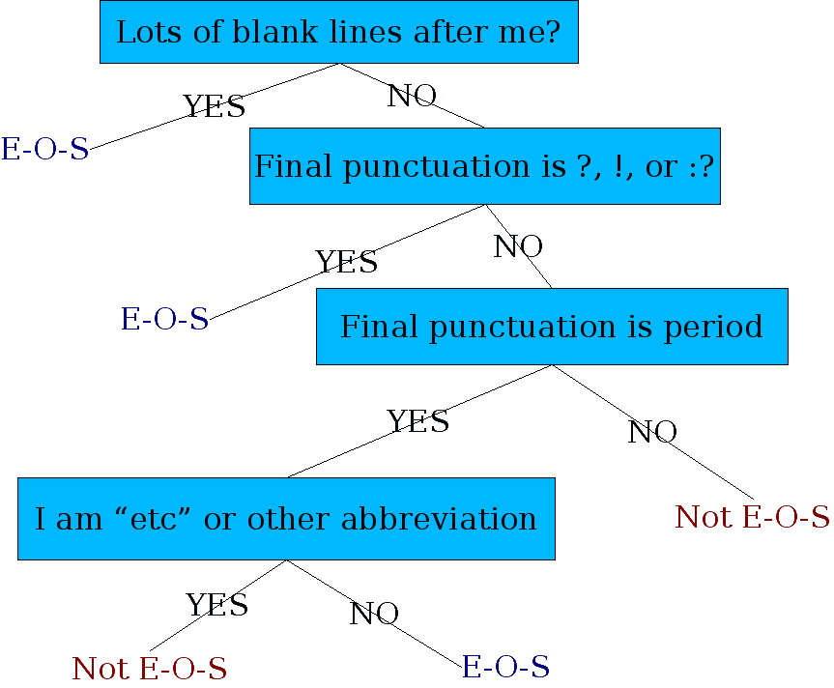
Determining if a word is end-of-sentence: a Decision Tree

Slide 34
More sophisticated decision tree features
Case of word with “.”: Upper, Lower, Cap, Number
Case of word after “.”: Upper, Lower, Cap, Number
Numeric features
Length of word with “.”
Probability(word with “.” occurs at end-of-s)
Probability(word after “.” occurs at beginning-of-s)

Slide 35
Implementing Decision Trees
A decision tree is just an if-then-else statement
The interesting research is choosing the features
Setting up the structure is often too hard to do by hand
Hand-building only possible for very simple features, domains
For numeric features, it’s too hard to pick each threshold
Instead, structure usually learned by machine learning from a training corpus

Slide 36
Decision Trees and other classifiers
We can think of the questions in a decision tree
As features that could be exploited by any kind of classifier
Logistic regression
SVM
Neural Nets
etc.

Slide 37
Recap: Text Classification and Naïve Bayes
Parameter Estimation and Smoothing

Slide 38
Recap: Naïve Bayes Simplifying Assumptions
Bag of Words assumption: Assume position doesn’t matter
Conditional Independence: Assume the feature probabilities P(x_{i}|c_{j}) are independent given the class c.

Slide 39
Learning the Multinomial Naïve Bayes Model
Sec.13.3
First attempt: maximum likelihood estimates, which simply use the frequencies in the data
Notes:
c_j = class j

Slide 40
Recap: Parameter estimation
fraction of times word w_{i} appears
among all words in documents of topic c_{j}
Create mega-document for topic j by concatenating all docs in this topic
Use frequency of w in mega-document

Slide 41
Recap: Problem with Maximum Likelihood
Sec.13.3
What if we have seen no training documents with the word fantastic and classified in the topic positive (thumbs-up)?
Zero probabilities cannot be conditioned away, no matter the other evidence!

Slide 42
Recap: Laplace (add-1) smoothing for Naïve Bayes

Slide 43
Logistic Regression
Jurafsky and Martin Chapter 5

Slide 44
Generative v. Discriminative Classifiers and cats v. dogs
Naive Bayes is a generative classifier
Logistic regression is a is a discriminiative classifier
Notes:
imagine we’re trying to distinguish dog images from cat images. A generative model would have the goal of understanding what dogs look like and what cats look like. You might literally ask such a model to ‘generate’, i.e. draw, a dog. Given a test image, the system then asks whether it’s the cat model or the dog model that better fits (is less surprised by) the image, and chooses that as its label.
A discriminative model, by contrast, is only try- ing to learn to distinguish the classes (perhaps with- out learning much about them). So maybe all the dogs in the training data are wearing collars and the cats aren’t. If that one feature neatly separates the classes, the model is satisfied. If you ask such a model what it knows about cats all it can say is that they don’t wear collars.

Slide 45
Tanks v. no tanks
A (possibly apocryphal) tale in artificial intelligence tells about researchers training a neural network to detect tanks in photographs for a DARPA project.
They apparently succeed. Great let’s deploy it! Oops! It didn’t work as well as we thought it would. Later they realized the photographs had been collected under specific conditions for tanks/non-tanks and the classifier had simply learned to distinguish between the time of day.
Notes:
https://www.gwern.net/Tanks

Slide 46
Generative v. Discriminative Classifiers
Naïve Bayes doesn’t directly compute P(c|d). Instead it computes it using two terms: A generative model uses the likelihood term, which expresses how to generate the features of a document if we knew it was of class c.
A discriminative model attempts to directly compute P(c|d). It may learn to assign a high weight to document features that directly improve its ability to discriminate between classes
Unlike the generative model, good paramters estimates for a discriminative model don’t help it generate an example of one of the classes.

Slide 47
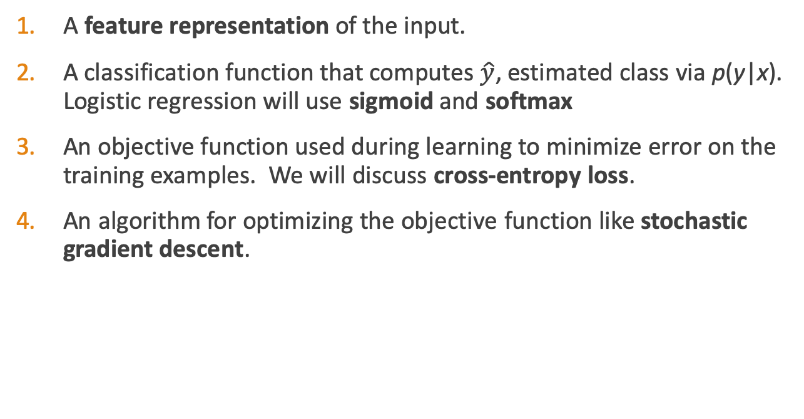
Classifier components
A feature representation of the input.
A classification function that computes $\hat{y}$, estimated class via p(y|x). Logistic regression will use sigmoid and softmax
An objective function used during learning to minimize error on the training examples. We will discuss cross-entropy loss.
An algorithm for optimizing the objective function like stochastic gradient descent.

Slide 48
Sentiment classifier
Input: "Spiraling away from narrative control as its first three episodes unreel, this series, about a post-apocalyptic future in which nearly everyone is blind, wastes the time of Jason Momoa and Alfre Woodard, among others, on a story that starts from a position of fun, giddy strangeness and drags itself forward at a lugubrious pace."
Output: positive (1) or negative (0)

Slide 49
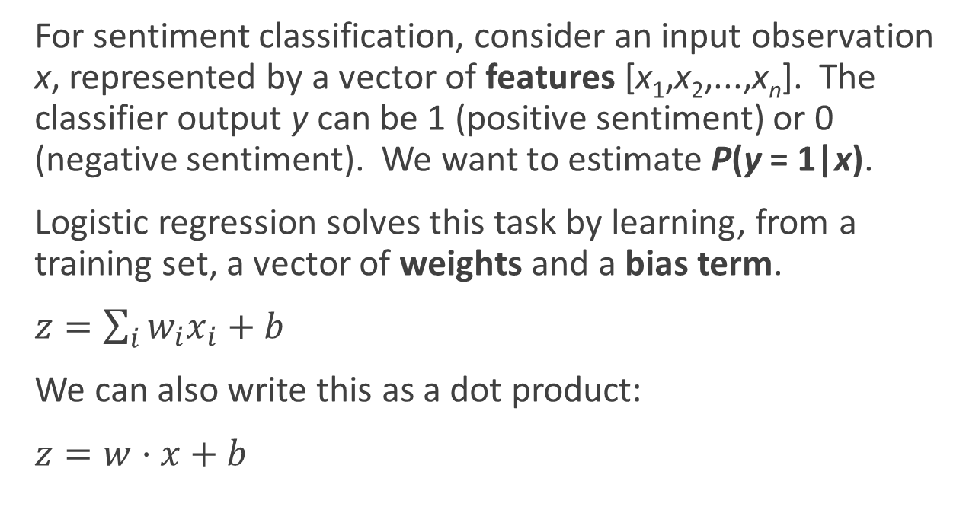
Sentiment classifier
For sentiment classification, consider an input observation x, represented by a vector of features [x₁,x₂,...,x_{n}]. The classifier output y can be 1 (positive sentiment) or 0 (negative sentiment). We want to estimate P(y = 1|x).
Logistic regression solves this task by learning, from a training set, a vector of weights and a bias term.
$z=\sum_{i}{w_{i}x_{i}+b}$
We can also write this as a dot product:
$z=w⋅x+b$
Notes:
The weight wi represents how important that input feature is to the classification decision, and can be positive (meaning the feature is associated with the class) or negative (meaning the feature is not associated with the class). Thus we might expect in a sentiment task the word awesome to have a high positive weight, and abysmal to have a very negative weight. The bias term, also called the intercept, is another real number that’s added to the weighted inputs.
But note that nothing forces z to be a legal probability, that is, to lie between 0 and 1. In fact, since weights are real-valued, the output might even be negative; z ranges from −∞ to ∞.

Slide 50
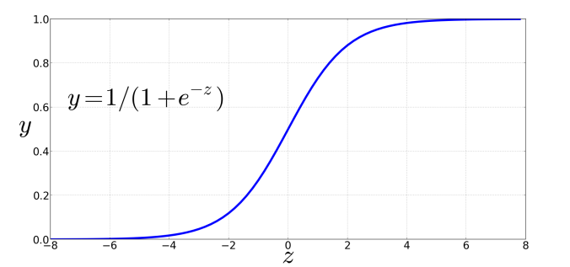
Sigmoid function
Notes:
But note that nothing forces z to be a legal probability, that is, to lie between 0 and 1. In fact, since weights are real-valued, the output might even be negative; z ranges from −∞ to ∞.
To create a probability, we’ll pass z through the sigmoid function, σ(z). The sigmoid function (named because it looks like an s) is also called the logistic func- tion, and gives logistic regression its name.

Slide 51
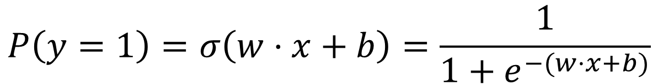
Probabilities
$$P\left(y=1\right)=σ\left(w⋅x+b\right)=\frac{1}{1+e^{−(w⋅x+b)}}$$

Slide 52
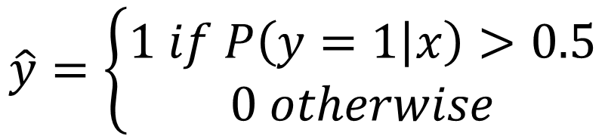
Decision boundary
Now we have an algorithm that given an instance x computes the probability P(y = 1|x). How do we make a decision?
For a test instance x, we say yes if the probability P(y = 1|x) is more than .5, and no otherwise. We call .5 the decision boundary
$$\hat{y}=\left\{\begin{aligned}1 if P\left(y=1 | x\right)>0.5 \\ 0 otherwise\end{aligned}\right.$$
Notes:
Now we have an algorithm that given an instance x computes the probability P(y = 1|x). How do we make a decision? For a test instance x, we say yes if the probability P(y = 1|x) is more than .5, and no otherwise. We call .5 the decision boundary

Slide 53
Extracting Features
It's hokey. There are virtually no surprises , and the writing is second-rate . So why was it so enjoyable? For one thing , the cast is great . Another nice touch is the music . I was overcome with the urge to get off the couch and start dancing . It sucked me in , and it'll do the same to you .
Var | Definition | Value
x₁ | Count of positive lexicon words
x₂ | Count of negative lexicon words
x₃ | Does no appear? (binary feature)
x₄ | Number of 1st and 2nd person pronouns
x₅ | Does ! appear? (binary feature)
x₆ | Log of the word count for the document

Slide 54
Extracting Features
It's hokey. There are virtually no surprises , and the writing is second-rate . So why was it so enjoyable? For one thing , the cast is great . Another nice touch is the music . I was overcome with the urge to get off the couch and start dancing . It sucked me in , and it'll do the same to you .
Var | Definition | Value
x₁ | Count of positive lexicon words | 3
x₂ | Count of negative lexicon words
x₃ | Does no appear? (binary feature)
x₄ | Number of 1st and 2nd person pronouns
x₅ | Does ! appear? (binary feature)
x₆ | Log of the word count for the document

Slide 55
Extracting Features
It's hokey. There are virtually no surprises , and the writing is second-rate . So why was it so enjoyable? For one thing , the cast is great . Another nice touch is the music . I was overcome with the urge to get off the couch and start dancing . It sucked me in , and it'll do the same to you .
Var | Definition | Value
x₁ | Count of positive lexicon words | 3
x₂ | Count of negative lexicon words | 2
x₃ | Does no appear? (binary feature)
x₄ | Number of 1st and 2nd person pronouns
x₅ | Does ! appear? (binary feature)
x₆ | Log of the word count for the document

Slide 56
Extracting Features
It's hokey. There are virtually no surprises , and the writing is second-rate . So why was it so enjoyable? For one thing , the cast is great . Another nice touch is the music . I was overcome with the urge to get off the couch and start dancing . It sucked me in , and it'll do the same to you .
Var | Definition | Value
x₁ | Count of positive lexicon words | 3
x₂ | Count of negative lexicon words | 2
x₃ | Does no appear? (binary feature) | 1
x₄ | Number of 1st and 2nd person pronouns
x₅ | Does ! appear? (binary feature)
x₆ | Log of the word count for the document

Slide 57
Extracting Features
It's hokey. There are virtually no surprises , and the writing is second-rate . So why was it so enjoyable? For one thing , the cast is great . Another nice touch is the music . I was overcome with the urge to get off the couch and start dancing . It sucked me in , and it'll do the same to you .
Var | Definition | Value
x₁ | Count of positive lexicon words | 3
x₂ | Count of negative lexicon words | 2
x₃ | Does no appear? (binary feature) | 1
x₄ | Number of 1st and 2nd person pronouns | 3
x₅ | Does ! appear? (binary feature)
x₆ | Log of the word count for the document

Slide 58
Extracting Features
It's hokey. There are virtually no surprises , and the writing is second-rate . So why was it so enjoyable? For one thing , the cast is great . Another nice touch is the music . I was overcome with the urge to get off the couch and start dancing . It sucked me in , and it'll do the same to you .
Word count = 64, ln(64) = 4.15
Var | Definition | Value
x₁ | Count of positive lexicon words | 3
x₂ | Count of negative lexicon words | 2
x₃ | Does no appear? (binary feature) | 1
x₄ | Number of 1st and 2nd person pronouns | 3
x₅ | Does ! appear? (binary feature) | 0
x₆ | Log of the word count for the document | 4.15

Slide 59
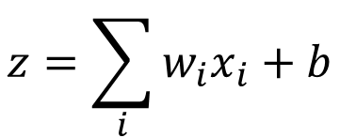
Var | Definition | Value | Weight | Product
x₁ | Count of positive lexicon words | 3 | 2.5
x₂ | Count of negative lexicon words | 2 | -5.0
x₃ | Does no appear? (binary feature) | 1 | -1.2
x₄ | Num 1st and 2nd person pronouns | 3 | 0.5
x₅ | Does ! appear? (binary feature) | 0 | 2.0
x₆ | Log of the word count for the doc | 4.15 | 0.7
b | bias | 1 | 0.1
$$z=\sum_{i}{w_{i}x_{i}+b}$$

Slide 60
Computing Z
Var | Definition | Value | Weight | Product
x₁ | Count of positive lexicon words | 3 | 2.5 | 7.5
x₂ | Count of negative lexicon words | 2 | -5.0 | -10
x₃ | Does no appear? (binary feature) | 1 | -1.2 | -1.2
x₄ | Num 1st and 2nd person pronouns | 3 | 0.5 | 1.5
x₅ | Does ! appear? (binary feature) | 0 | 2.0 | 0
x₆ | Log of the word count for the doc | 4.15 | 0.7 | 2.905
b | bias | 1 | 0.1 | .1
$$z=\sum_{i}{w_{i}x_{i}+b}$$
z=0.805

Slide 61
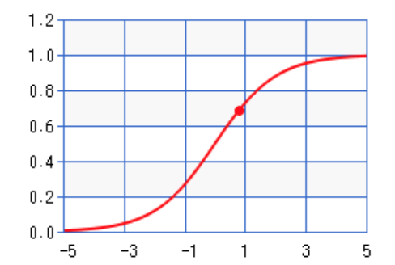
Sigmoid(Z)
Var | Definition | Value | Weight | Product
x₁ | Count of positive lexicon words | 3 | 2.5 | 7.5
x₂ | Count of negative lexicon words | 2 | -5.0 | -10
x₃ | Does no appear? (binary feature) | 1 | -1.2 | -1.2
x₄ | Num 1st and 2nd person pronouns | 3 | 0.5 | 1.5
x₅ | Does ! appear? (binary feature) | 0 | 2.0 | 0
x₆ | Log of the word count for the doc | 4.15 | 0.7 | 2.905
b | bias | 1 | 0.1 | .1
σ(0.805)
= 0.69
Notes:
So the probability that this is a positive review = 69%. The probability that it’s a negative review is 31%

Slide 62
Learning in logistic regression
How do we get the weights of the model? We learn the parameters (weights + bias) via learning. This requires 2 components:
An objective function or loss function that tells us distance between the system output and the gold output. We will use cross-entropy loss.
An algorithm for optimizing the objective function. We will use stochastic gradient descent to minimize the loss function.

Slide 63
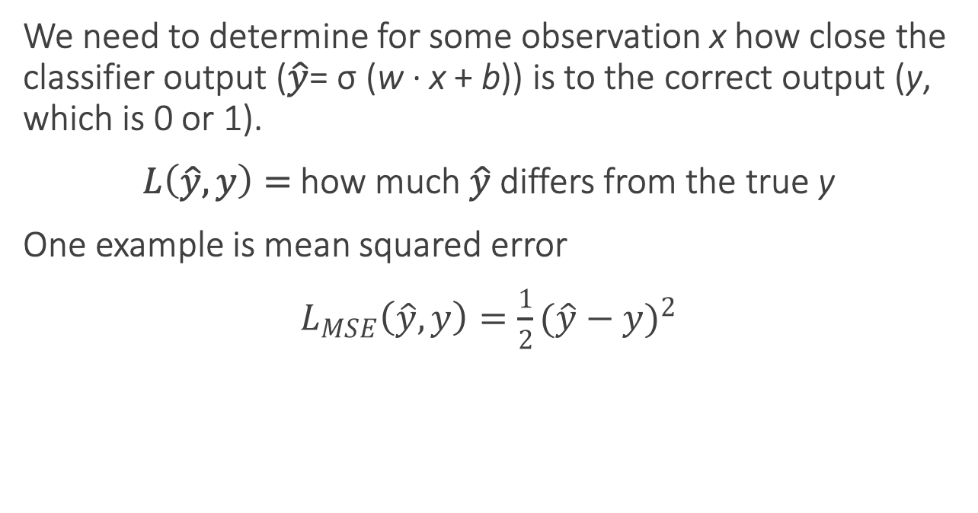
Loss functions
We need to determine for some observation x how close the classifier output ($\hat{y}$= σ (w · x + b)) is to the correct output (y, which is 0 or 1).
$L\left(\hat{y}, y\right)=$how much $\hat{y}$ differs from the true y
One example is mean squared error
$L_{MSE}\left(\hat{y}, y\right)=\frac{1}{2}{(\hat{y}−y)}^{2}$
Notes:
It turns out that this MSE loss, which is very useful for some algorithms like linear regression, becomes harder to optimize (technically, non-convex), when it’s applied to probabilistic classification.
https://towardsdatascience.com/why-not-mse-as-a-loss-function-for-logistic-regression-589816b5e03c

Slide 64
Loss functions for probabilistic classification
We use a loss function that prefers the correct class labels of the training example to be more likely.
Conditional maximum likelihood estimation: Choose parameters w, b that maximize the (log) probabilities of the true labels in the training data.
The resulting loss function is the negative log likelihood loss, more commonly called the cross entropy loss.

Slide 65
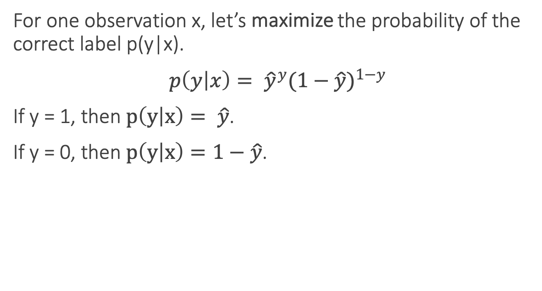
Loss functions for probabilistic classification
For one observation x, let’s maximize the probability of the correct label p(y|x).
$p\left(y | x\right)= {\hat{y}}^{y}{(1−\hat{y})}^{1−y}$
If y = 1, then $p\left(y | x\right)= \hat{y}$.
If y = 0, then $p\left(y | x\right)=1−\hat{y}$.

Slide 66
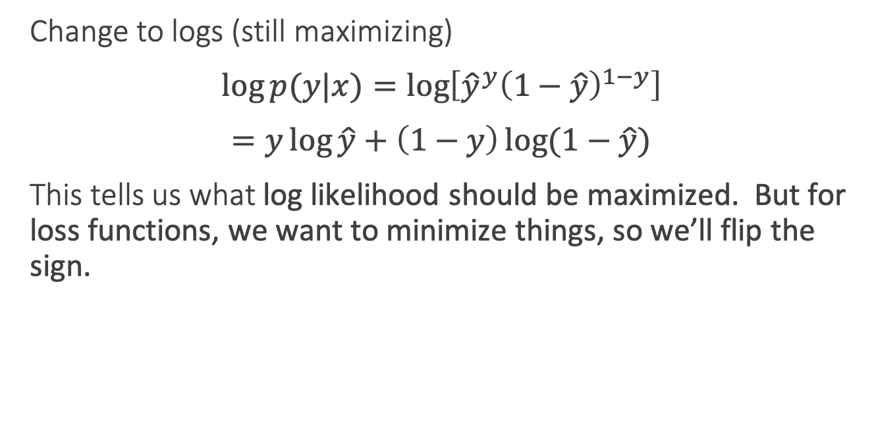
Loss functions for probabilistic classification
Change to logs (still maximizing)
$\log{p(y|x)}=\log\left[{\hat{y}}^{y}{\left(1−\hat{y}\right)}^{1−y}\right]$
$=y\log{\hat{y}}+\left(1−y\right)\log{(1−\hat{y})}$
This tells us what log likelihood should be maximized. But for loss functions, we want to minimize things, so we’ll flip the sign.

Slide 67
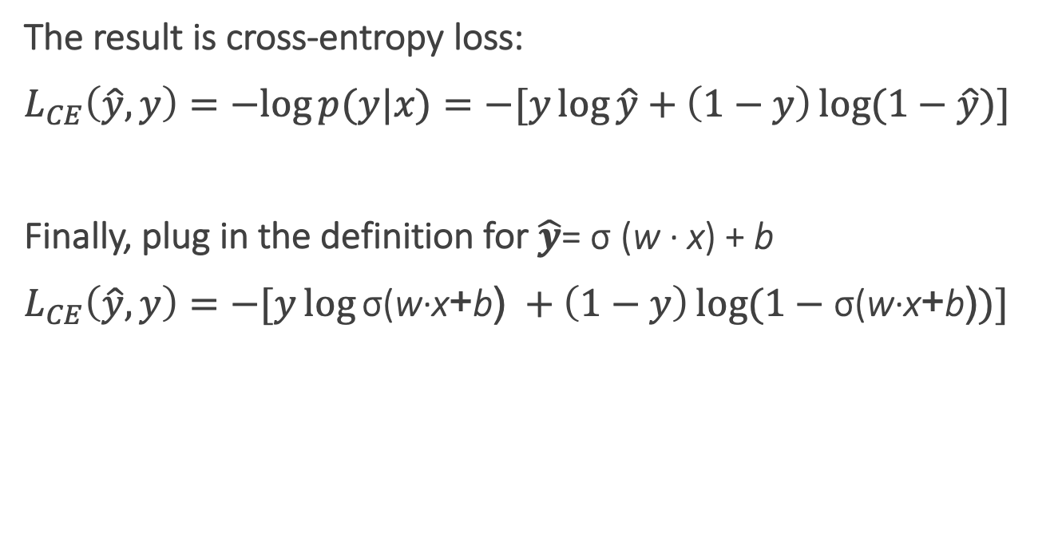
Cross-entropy loss
The result is cross-entropy loss:
$L_{CE}\left(\hat{y}, y\right)=−log{p(y|x)}=−[y\log{\hat{y}}+\left(1−y\right)\log{(1−\hat{y})]}$
Finally, plug in the definition for $\hat{y}$= σ (w · x) + b
$L_{CE}\left(\hat{y}, y\right)=−[y\log{\text{σ}\text{(}\text{w}\text{·}\text{x}\text{+}\text{b}\text{)} }+\left(1−y\right)\log{(1−\text{σ}\text{(}\text{w}\text{·}\text{x}\text{+}\text{b}\text{)})]}$
Notes:
In information theory, the cross entropy between two probability distributions p and q over the same underlying set of events measures the average number of bits needed to identify an event drawn from the set, if a coding scheme is used that is optimized for an "artificial" probability distribution q, rather than the "true" distribution p.
Information theoryEntropy
Differential entropy
Conditional entropy
Joint entropy
Mutual information
Conditional mutual information
Relative entropy
Entropy rate
Asymptotic equipartition property
Rate–distortion theory
Shannon's source coding theorem
Channel capacity
Noisy-channel coding theorem
Shannon–Hartley theorem
v

Slide 68
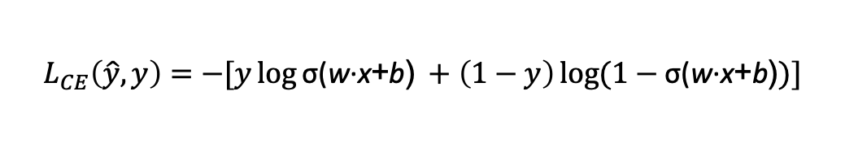
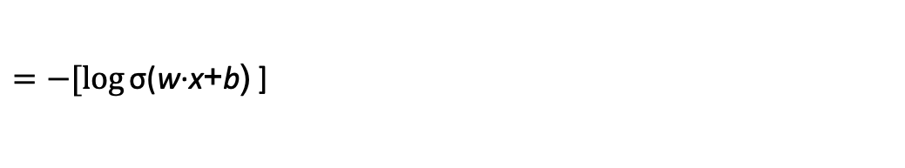
Cross-entropy loss
Why does minimizing this negative log probability do what we want? We want the loss to be smaller if the model’s estimate is close to correct, and we want the loss to be bigger if it is confused.
It's hokey. There are virtually no surprises , and the writing is second-rate . So why was it so enjoyable? For one thing , the cast is great . Another nice touch is the music . I was overcome with the urge to get off the couch and start dancing . It sucked me in , and it'll do the same to you .
P(sentiment=1|It’s hokey...) = 0.69. Let’s say y=1.
$$L_{CE}\left(\hat{y}, y\right)=−[y\log{\text{σ}\text{(}\text{w}\text{·}\text{x}\text{+}\text{b}\text{)} }+\left(1−y\right)\log{(1−\text{σ}\text{(}\text{w}\text{·}\text{x}\text{+}\text{b}\text{)})]}$$
$=−[\log{\text{σ}\text{(}\text{w}\text{·}\text{x}\text{+}\text{b}\text{)} }$]
$$=−\log{\text{(}\text{0.69}\text{)}=0.37}$$
Notes:
This loss function also ensures that as probability of the correct answer is maximized, the probability of the incorrect answer is minimized; since the two sum to one, any increase in the probability of the correct answer is coming at the expense of the incorrect answer.

Slide 69
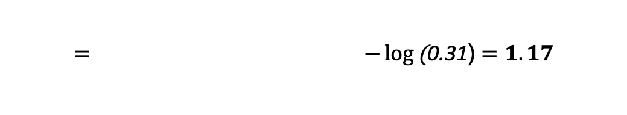
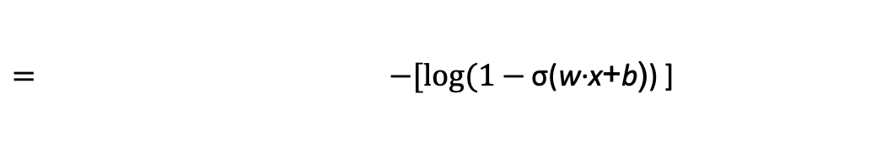
Cross-entropy loss
Why does minimizing this negative log probability do what we want? We want the loss to be smaller if the model’s estimate is close to correct, and we want the loss to be bigger if it is confused.
It's hokey. There are virtually no surprises , and the writing is second-rate . So why was it so enjoyable? For one thing , the cast is great . Another nice touch is the music . I was overcome with the urge to get off the couch and start dancing . It sucked me in , and it'll do the same to you .
P(sentiment=1|It’s hokey...) = 0.69. Let’s pretend y=0.
$$L_{CE}\left(\hat{y}, y\right)=−[y\log{\text{σ}\text{(}\text{w}\text{·}\text{x}\text{+}\text{b}\text{)} }+\left(1−y\right)\log{(1−\text{σ}\text{(}\text{w}\text{·}\text{x}\text{+}\text{b}\text{)})]}$$
$= −[log(1−{\text{σ}\text{(}\text{w}\text{·}\text{x}\text{+}\text{b}\text{)}\text{)} }$]
$$= −\log{\text{(}\text{0.31}\text{)}=1.17}$$
Notes:
This loss function also ensures that as probability of the correct answer is maximized, the probability of the incorrect answer is minimized; since the two sum to one, any increase in the probability of the correct answer is coming at the expense of the incorrect answer.

Slide 70
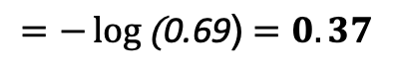
Cross-entropy loss
Why does minimizing this negative log probability do what we want? We want the loss to be smaller if the model’s estimate is close to correct, and we want the loss to be bigger if it is confused.
It's hokey. There are virtually no surprises , and the writing is second-rate . So why was it so enjoyable? For one thing , the cast is great . Another nice touch is the music . I was overcome with the urge to get off the couch and start dancing . It sucked me in , and it'll do the same to you .
If our prediction is correct, then our CE loss is lower
If our prediction is incorrect, then our CE loss is higher
$$=−\log{\text{(}\text{0.69}\text{)}=0.37}$$
$−\log{\text{(}\text{0.31}\text{)}=1.17}$
Notes:
Why does minimizing this negative log probability do what we want? A per- fect classifier would assign probability 1 to the correct outcome (y=1 or y=0) and probability 0 to the incorrect outcome. That means the higher yˆ (the closer it is to 1), the better the classifier; the lower yˆ is (the closer it is to 0), the worse the clas- sifier. The negative log of this probability is a convenient loss metric since it goes from 0 (negative log of 1, no loss) to infinity (negative log of 0, infinite loss). This loss function also ensures that as the probability of the correct answer is maximized, the probability of the incorrect answer is minimized; since the two sum to one, any increase in the probability of the correct answer is coming at the expense of the in- correct answer.

Slide 71
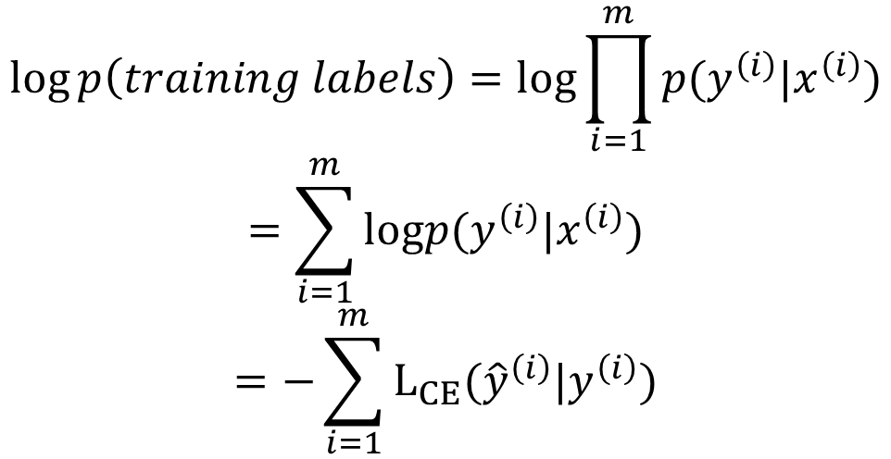
Loss on all training examples
$$\log{p\left(training labels\right)=log\prod_{i=1}^{m}{p(y^{\left(i\right)}|x^{\left(i\right)})}}$$
$$=\sum_{i=1}^{m}{logp(y^{\left(i\right)}|x^{\left(i\right)})}$$
$$=−\sum_{i=1}^{m}{L_{CE}({\hat{y}}^{\left(i\right)}|y^{\left(i\right)})}$$

Slide 72
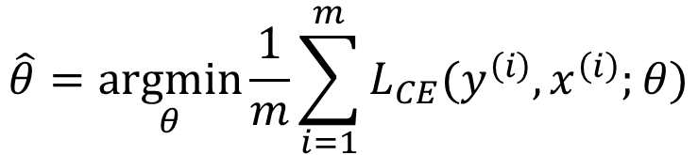
Finding good parameters
We use gradient descent to find good settings for our weights and bias by minimizing the loss function.
Gradient descent is a method that finds a minimum of a function by figuring out in which direction (in the space of the parameters θ) the function’s slope is rising the most steeply, and moving in the opposite direction.
$$\hat{θ}=\underset{θ}{argmin}{\frac{1}{m}\sum_{i=1}^{m}{L_{CE}(y^{\left(i\right)},x^{\left(i\right)};θ)}}$$
Notes:
Our goal with gradient descent is to find the optimal weights: minimize the loss function we’ve defined for the model. In Eq. 5.16 below, we’ll explicitly represent the fact that the loss function L is parameterized by the weights, which we’ll refer to in machine learning in general as θ (in the case of logistic regression θ = w, b)

Slide 73
Gradient descent
Notes:
The intuition is that if you are skiing in a canyon and trying to descend most quickly down to the river at the bottom, you might look around yourself 360 degrees, find the direction where the ground is sloping the steepest, and godownhill in that direction.

Slide 74
Global v. Local Minimums
For logistic regression, this loss function is conveniently convex.
A convex function has just one minimum, so there are no local minima to get stuck in.
So gradient descent starting from any point is guaranteed to find the minimum.
Notes:
By contrast, the loss for multi-layer neural networks is non-convex, and gradient descent may get stuck in local minima for neural network training and never find the global optimum

Slide 75
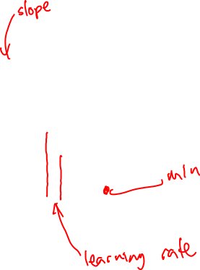
Iteratively find minimum
Notes:
The gradient descent algorithm answers this question by finding the gradient of the loss function at the current point and moving in the opposite direction. The gradient of a function of many variables is a vector pointing in the direction the greatest increase in a function. The gradient is a multi-variable generalization of the slope, so for a function of one variable like the one in Fig. 5.3, we can informally think of the gradient as the slope. The dotted line in Fig. 5.3 shows the slope of this hypothetical loss function at point w = w1. You can see that the slope of this dotted line is negative. Thus to find the minimum, gradient descent tells us to go in the opposite direction: moving w in a positive direction.
The first step in iteratively finding the minimum of this loss function, by moving w in the reverse direction from the slope of the function. Since the slope is negative, we need to move w in a positive direction, to the right. Here superscripts are used for learning steps, so w1 means the initial value of w (which is 0), w2 at the second step, and so on.

Slide 76

How much should we update the parameter by?
The magnitude of the amount to move in gradient descent is the value of the slope weighted by a learning rate η.
A higher/faster learning rate means that we should move w more on each step.
Notes:
η = eta. Is the learning rate
The change we make in our parameter is the
learning rate times the gradient (or the slope, in our single-variable example)
In each dimension wi, we express the slope as a partial derivative ∂ of the loss ∂wi
function.
The magnitude of the amount to move in gradient descent is the value of the slope d f (x; w) weighted by a learning rate η . A higher (faster) learning rate means that
dw we should move w more on each step. The change we make in our parameter is the
learning rate times the gradient (or the slope, in our single-variable example):

Slide 77
Many dimensions
Notes:
Now let’s extend the intuition from a function of one scalar variable w to many variables, because we don’t just want to move left or right, we want to know where in the N-dimensional space (of the N parameters that make up θ ) we should move. The gradient is just such a vector; it expresses the directional components of the sharpest slope along each of those N dimensions. If we’re just imagining two weight dimension (say for one weight w and one bias b), the gradient might be a vector with two orthogonal components, each of which tells us how much the ground slopes in the w dimension and in the b dimension.
In an actual logistic regression, the parameter vector w is much longer than 1 or 2, since the input feature vector x can be quite long, and we need a weight wi for each xi For each dimension/variable wi in w (plus the bias b), the gradient will have a component that tells us the slope with respect to that variable. Essentially we’re asking: “How much would a small change in that variable wi influence the total loss function L?”

Slide 78
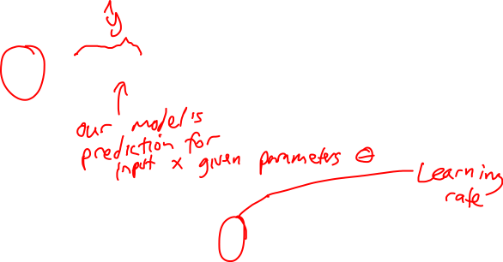
Updating each dimension w_{i}
The final equation for updating θ based on the gradient is
Notes:
In an actual logistic regression, the parameter vector w is much longer than 1 or 2, since the input feature vector x can be quite long, and we need a weight wi for each xi For each dimension/variable wi in w (plus the bias b), the gradient will have a component that tells us the slope with respect to that variable. Essentially we’re asking: “How much would a small change in that variable wi influence the total loss function L?”
In each dimension wi, we express the slope as a partial derivative ∂ of the loss ∂wi
function. The gradient is then defined as a vector of these partials. We’ll represent yˆ as f (x; θ ) to make the dependence on θ more obvious.
∇: Del, or nabla, is an operator used in mathematics, in particular in vector calculus, as a vector differential operator, usually represented by the nabla symbol ∇.

Slide 79
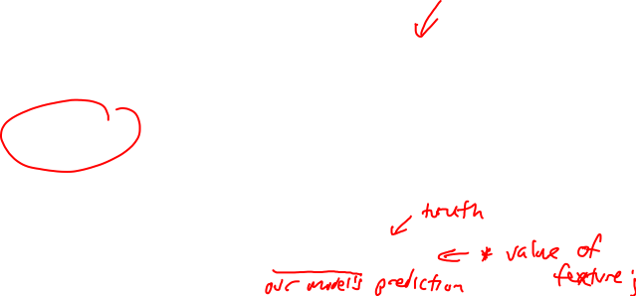
The Gradient
To update θ, we need a definition for the gradient ∇L( f (x; θ ), y).
For logistic regression the cross-entropy loss function is:
The derivative of this function for one observation vector x for a single weight w_{j} is
The gradient is a very intuitive value: the difference between the true y and our estimate for x, multiplied by the corresponding input value x_{j} .
Notes:
Note in Eq. 5.17 that the gradient with respect to a single weight w j represents a very intuitive value: the difference between the true y and our estimated yˆ = σ (w · x + b) for that observation, multiplied by the corresponding input value x j .

Slide 80
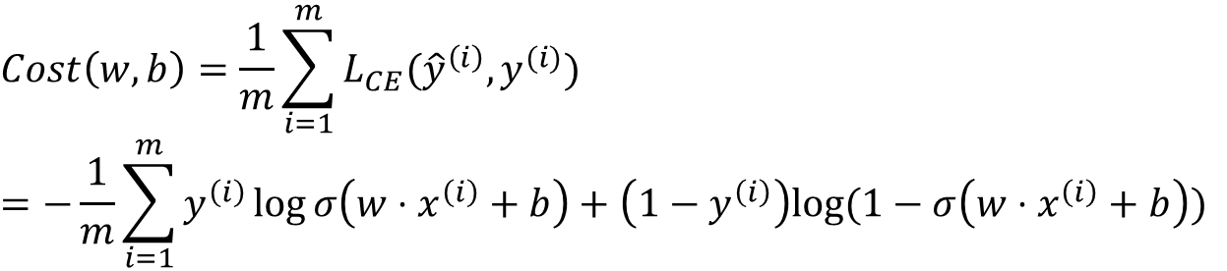
Average Loss
$$Cost\left(w,b\right)=\frac{1}{m}\sum_{i=1}^{m}{L_{CE}({\hat{y}}^{\left(i\right)},y^{(i)}})$$
$$=−\frac{1}{m}\sum_{i=1}^{m}{y^{\left(i\right)}\log{σ\left(w⋅x^{\left(i\right)}+b\right)}+\left(1−y^{\left(i\right)}\right)log⁡(1−σ\left(w⋅x^{\left(i\right)}+b\right))}$$
This is what we want to minimize!!

Slide 81
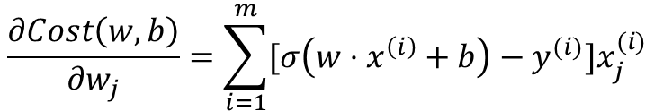
The Gradient
The loss for a batch of data or an entire dataset is just the average loss over the m examples
The gradient for multiple data points is the sum of the individual gradients:
$$Cost\left(w,b\right)=−\frac{1}{m}\sum_{i=1}^{m}{y^{(i)}\log{σ\left(w⋅x^{\left(i\right)}+b\right)+\left(1−y^{\left(i\right)}\right)\log{(1−σ\left(w⋅x^{\left(i\right)}+b\right))}}}$$
$$\frac{∂Cost\left(w,b\right)}{∂w_{j}}=\sum_{i=1}^{m}{[σ\left(w⋅x^{\left(i\right)}+b\right)−y^{(i)}}]x_{j}^{(i)}$$

Slide 82
Stochastic gradient descent algorithm
Notes:
Stochastic gradient descent is an online algorithm that minimizes the loss function by computing its gradient after each training example, and nudging θ in the right direction (the opposite direction of the gradient).
Stochastic gradient descent is called stochastic because it chooses a single random example at a time, moving the weights so as to improve performance on that single example. That can result in very choppy movements, so it’s also common to do minibatch gradient descent, which computes the gradient over batches of train- ing instances rather than a single instance.
The stochastic gradient descent algorithm. Step 1 (computing the loss) is used to report how well we are doing on the current tuple. The algorithm can terminate when it converges (or when the gradient < ε), or when progress halts (for example when the loss starts going up on a held-out set).
The learning rate η is a parameter that must be adjusted. If it’s too high, the learner will take steps that are too large, overshooting the minimum of the loss func- tion. If it’s too low, the learner will take steps that are too small, and take too long to get to the minimum. It is most common to begin the learning rate at a higher value, and then slowly decrease it, so that it is a function of the iteration k of training; you will sometimes see the notation ηk to mean the value of the learning rate at iteration k.

Slide 83
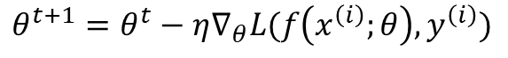
Worked example
Let’s walk though a single step of the gradient descent algorithm. We’ll use a simple sentiment classifier with just 2 features, and 1 training instance where the correct value is y = 1 (this is a positive review).
x₁ = 3 (count of positive lexicon words)
x₂ = 2 (count of positive negative words)
The initial weights and bias in θ⁰ are all set to 0, and the initial learning rate η is 0.1:
w₁ = w₂ = b = 0
η = 0.1
The single update step requires that we compute the gradient, multiplied by the learning rate:
$$θ^{t+1}=θ^{t}−η∇_{θ}L(f\left(x^{\left(i\right)};θ\right),y^{\left(i\right)})$$
Notes:
todo – add the worked example from textbook sectino 5.4.3

Slide 84
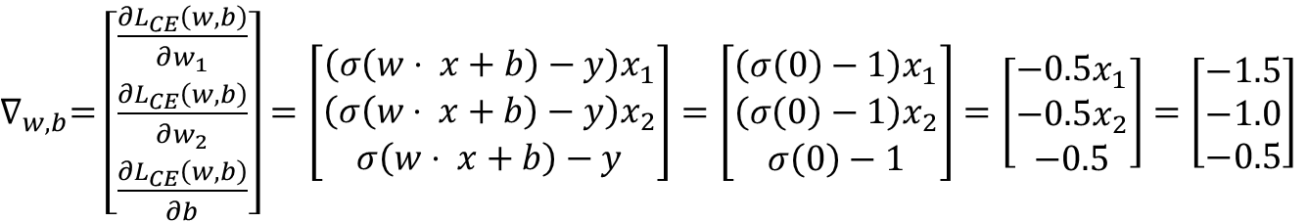
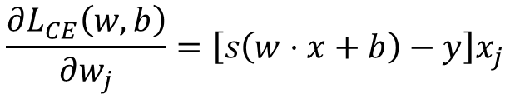
Worked example
The derivative of this function for a single training example x for a single weight w_{j} is
The gradient vector has 3 dimensions, for w₁, w₂, and b. For our input, x₁ = 3 and x₂ = 2
x₂ = 2
$$\frac{∂L_{CE}\left(w,b\right)}{∂w_{j}}=\left[s\left(w⋅x+b\right)−y\right]x_{j}$$
$∇_{w,b}=$ $\left[\begin{matrix}\frac{∂L_{CE}\left(w,b\right)}{∂w_{1}} \\ \frac{∂L_{CE}\left(w,b\right)}{∂w_{2}} \\ \frac{∂L_{CE}\left(w,b\right)}{∂b}\end{matrix}\right]=\left[\begin{matrix}\left(σ\left(w⋅ x+b\right)−y\right)x_{1} \\ \left(σ\left(w⋅ x+b\right)−y\right)x_{2} \\ σ\left(w⋅ x+b\right)−y\end{matrix}\right]=\left[\begin{matrix}\left(σ\left(0\right)−1\right)x_{1} \\ \left(σ\left(0\right)−1\right)x_{2} \\ σ\left(0\right)−1\end{matrix}\right]=\left[\begin{matrix}−0.5x_{1} \\ −0.5x_{2} \\ −0.5\end{matrix}\right]=\left[\begin{matrix}−1.5 \\ −1.0 \\ −0.5\end{matrix}\right]$
Notes:
todo – add the worked example from textbook sectino 5.4.3

Slide 85
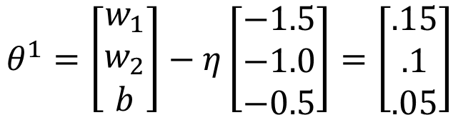
Worked example
Now that we have a gradient ∇_{w,b} , we compute the new parameter vector θ¹ by moving θ⁰ in the opposite direction from the gradient:
So after one step of gradient descent, the weights have shifted to be:
w₁ = 0.15, w₂ = 0.1, and b= .05
$$θ^{1}=\left[\begin{matrix}w_{1} \\ w_{2} \\ b\end{matrix}\right]−η\left[\begin{matrix}−1.5 \\ −1.0 \\ −0.5\end{matrix}\right]=\left[\begin{matrix}.15 \\ .1 \\ .05\end{matrix}\right]$$
Notes:
Note that this observation x happened to be a positive example. We would expect that after seeing more negative examples with high counts of negative words, that the weight w2 would shift to have a negative value.

Slide 86
Mini-batch training
Stochastic gradient descent chooses a single random example at a time, and updates its weights on that example. As a result the updates can fluctuate.
An alternate is batch training, which computes the gradient over the entire dataset. This gives a much better estimate of which direction to move the weights, but takes a long time to compute.
A commonly used compromise is mini-batch training, where we train on a small batch. The batch size can be 512 or 1024, often selected based on computational resources, so that all examples in the mini-batch can be processed in parallel. The loss is then accumulated.

Slide 87
Regularization
Overfitting is a problem with many machine learning models. Overfitting results in poor generalization and poor performance on unseen test set.
In logistic regression, if a feature only occurs in one class then it will get a high weight. Sometimes we are just modelling noisy factors that just accidentally correlate with the class.
Regularization is a way to penalize large weights. A regularization term is added to the loss function.
Lasso regression uses L1 regularization Ridge regression uses L2 regularization
Notes:
There is a problem with learning weights that make the model perfectly match the training data. If a feature is perfectly predictive of the outcome because it happens to only occur in one class, it will be assigned a very high weight. The weights for features will attempt to perfectly fit details of the training set, in fact too perfectly, modeling noisy factors that just accid
entally correlate with the class. This problem is called overfitting.
L1 regularization is a linear function of the weight values, named after the L1 norm, the sum of the absolute values of the weights, or Manhattan distance
L2 regularization is a quadratic function of the weight values, named because it uses the (square of the) L2 norm of the weight values. The L2 norm, ||θ||2, is the same as the Euclidean distance of the vector θ from the origin.
L2 regularization is easier to optimize because of its simple derivative, while L1 regularization is more complex (the derivative is non-continuous at zero).

Slide 88
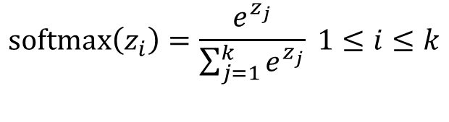
Multinomial logistic regression
Instead of binary classification, we often want more than two classes. For sentiment classification we might extend the class labels to be positive, negative, and neutral.
We want to know the probability of y for each class c ∈ C, p(y = c|x).
To get a proper probability, we will use a generalization of the sigmoid function called the softmax function.
$$\text{softmax}\left(z_{i}\right)=\frac{e^{z_{j}}}{\sum_{j=1}^{k}{e^{z_{j}}}} 1≤i≤k$$
Notes:
In such cases we use multinomial logistic regression, also called softmax re- gression (or, historically, the maxent classifier).
The softmax function takes a vector z = [z1,z2,...,zk] of k arbitrary values and maps them to a probability distribution, with each value in the range (0,1), and all the values summing to 1. Like the sigmoid, it is an exponential function.

Slide 89
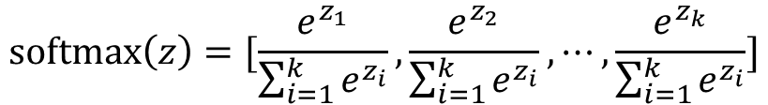
Softmax
The softmax function takes in an input vector z = [z₁,z₂,...,z_{k}] and outputs a vector of values normalized into probabilities.
For example, for this input:
z = [0.6, 1.1, −1.5, 1.2, 3.2, −1.1]
Softmax will output:
[0.056, 0.090, 0.007, 0.099, 0.74, 0.010]
$$\text{softmax}\left(z\right)=[\frac{e^{z_{1}}}{\sum_{i=1}^{k}{e^{z_{i}}}},\frac{e^{z_{2}}}{\sum_{i=1}^{k}{e^{z_{i}}}},⋯,\frac{e^{z_{k}}}{\sum_{i=1}^{k}{e^{z_{i}}}}]$$
Notes:
0.6+1.1 −1.5+1.2+3.2−1.1 = 3.5
0.054+0.090+0.007+0.099+0.74+0.010 = 1

Slide 90
Next time: Neural Nets
Notes:
https://upload.wikimedia.org/wikipedia/commons/8/84/Ski_Famille_-_Family_Ski_Holidays.jpg

